Slide 1
Training neural networks and back-propagation
王兴刚 廖振宇
https://zhenyu-liao.github.io/teaching/
华中科技大学 电信学院

Slide 2
调查问卷反馈情况：
不要给考研同学的压力
了解计算机视觉的前沿理论和知识，方向解读等
增加项目经验、coding水平、解决问题的能力

Slide 3
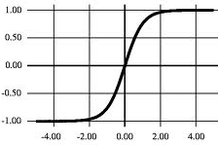
Neural network
g(x)
w₁
w₂
w₃
x₁
x₂
x₃

Slide 4
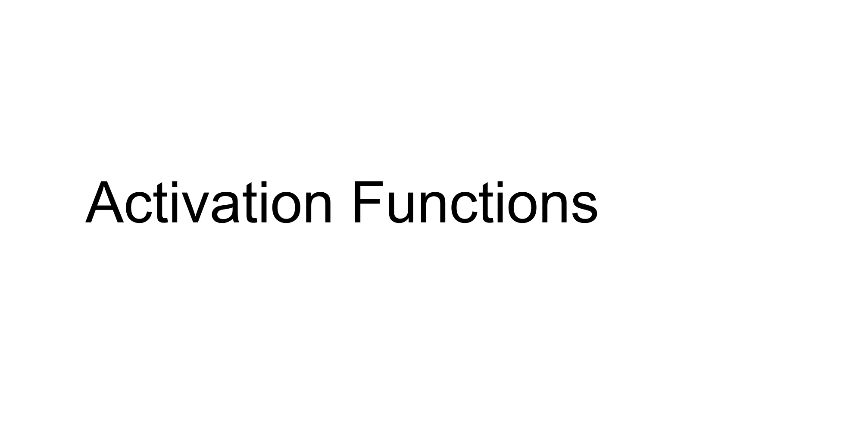

Slide 5
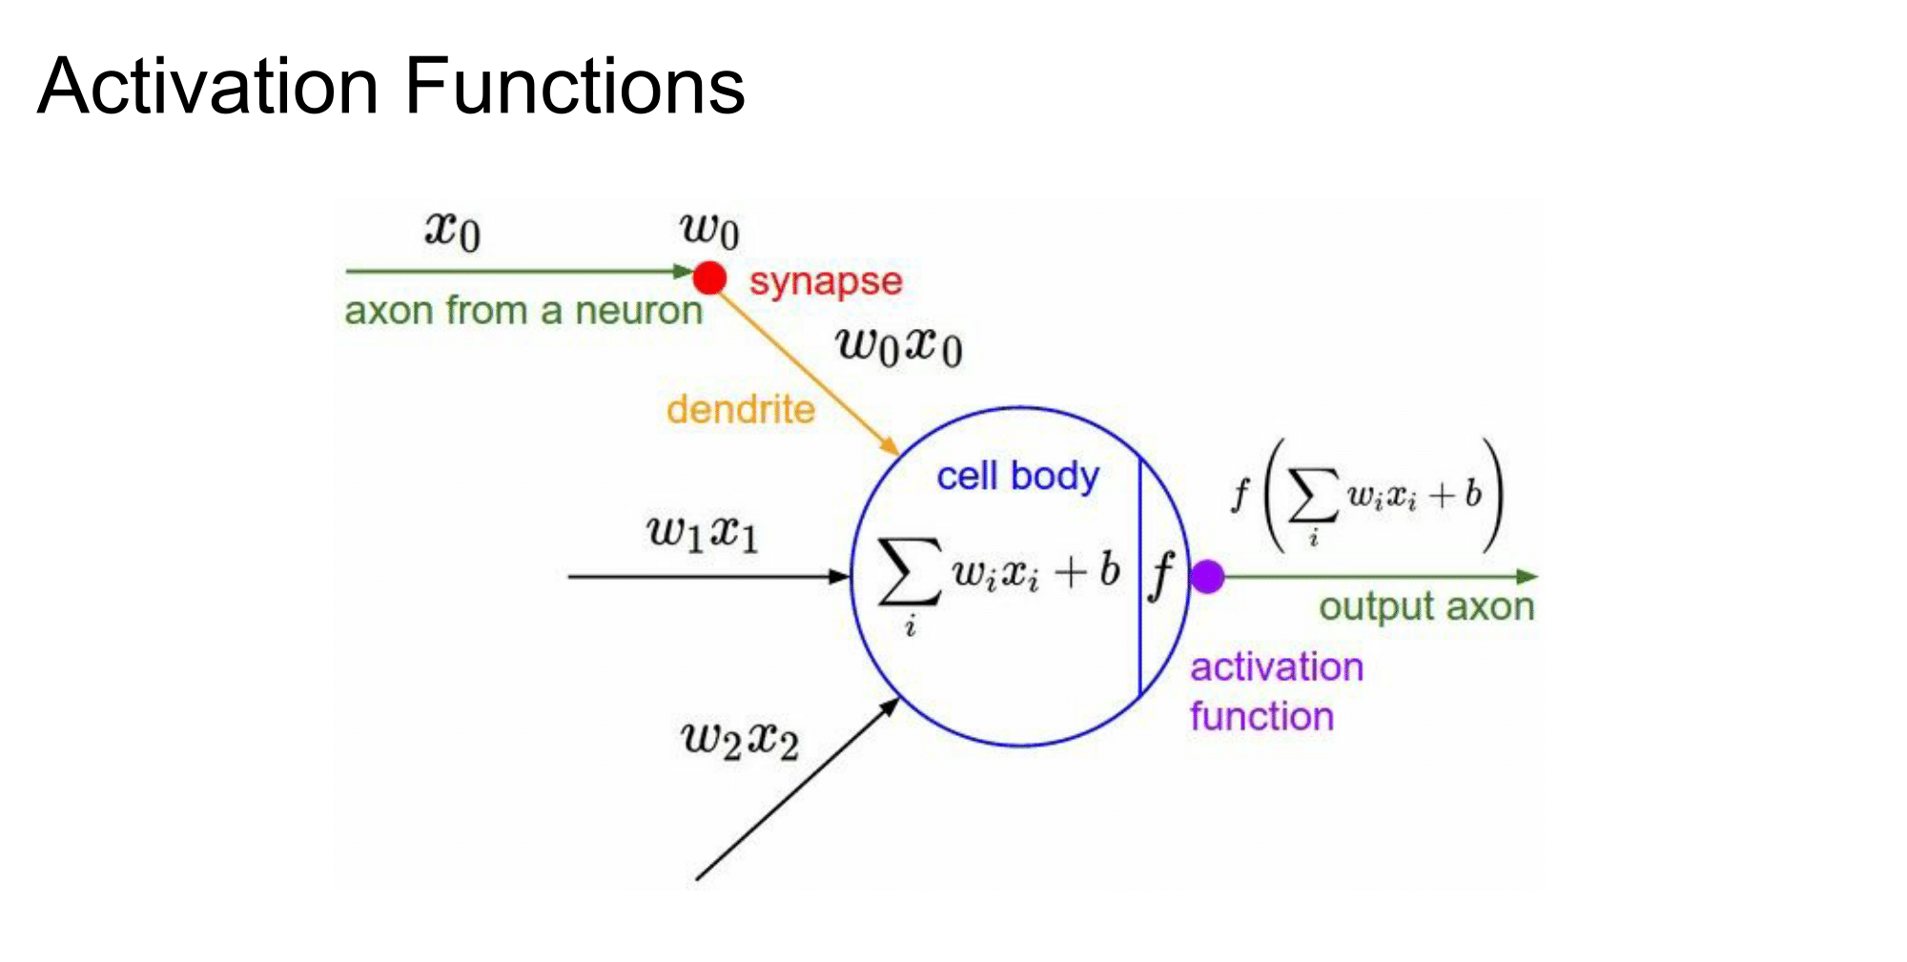

Slide 6
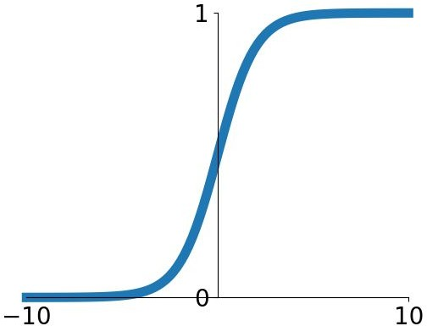
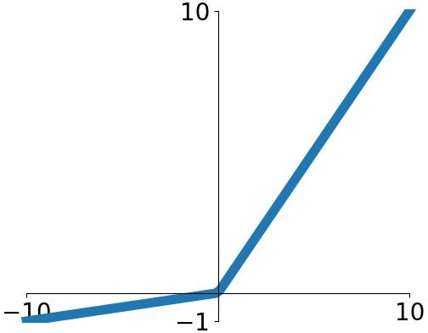
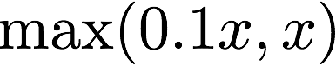
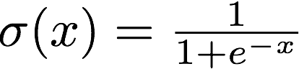
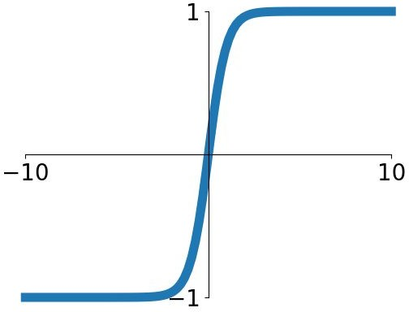
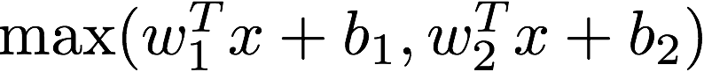
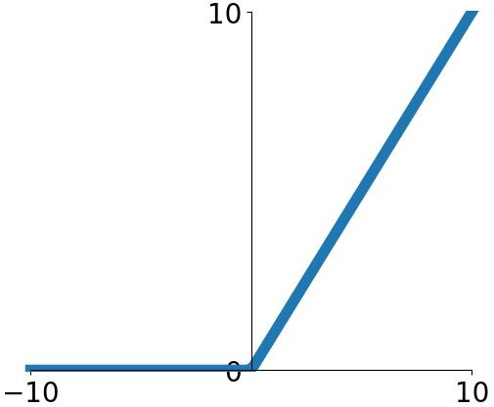
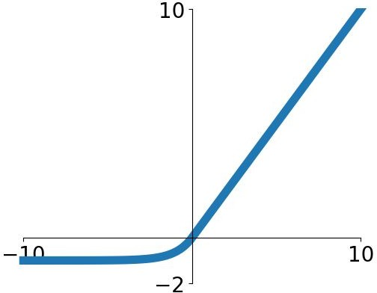
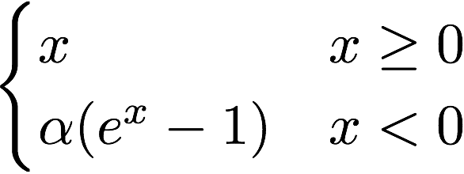
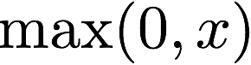
Activation functions
Sigmoid
tanh
Leaky ReLU
Maxout
ReLU
ELU

Slide 7
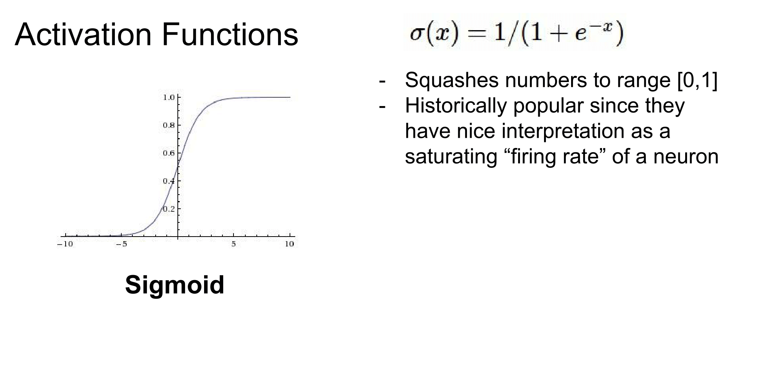
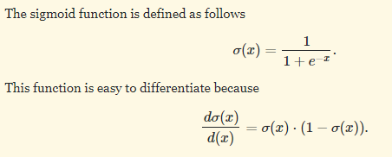

Slide 8
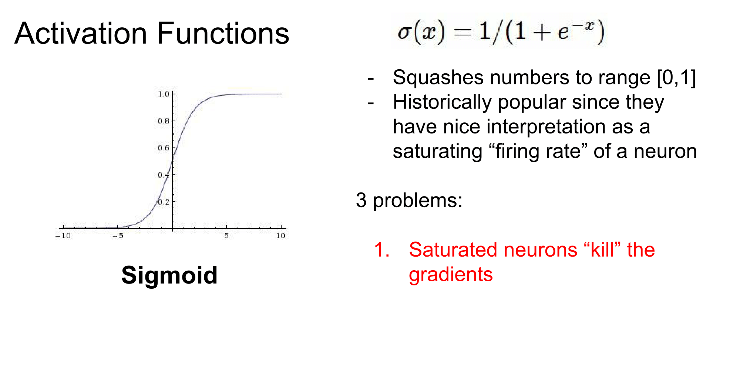

Slide 9
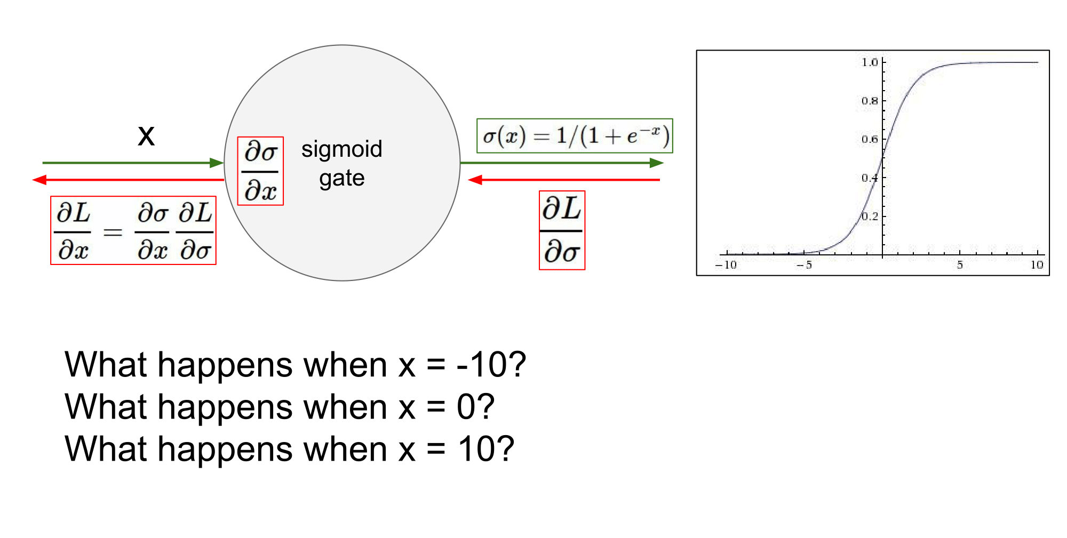

Slide 10
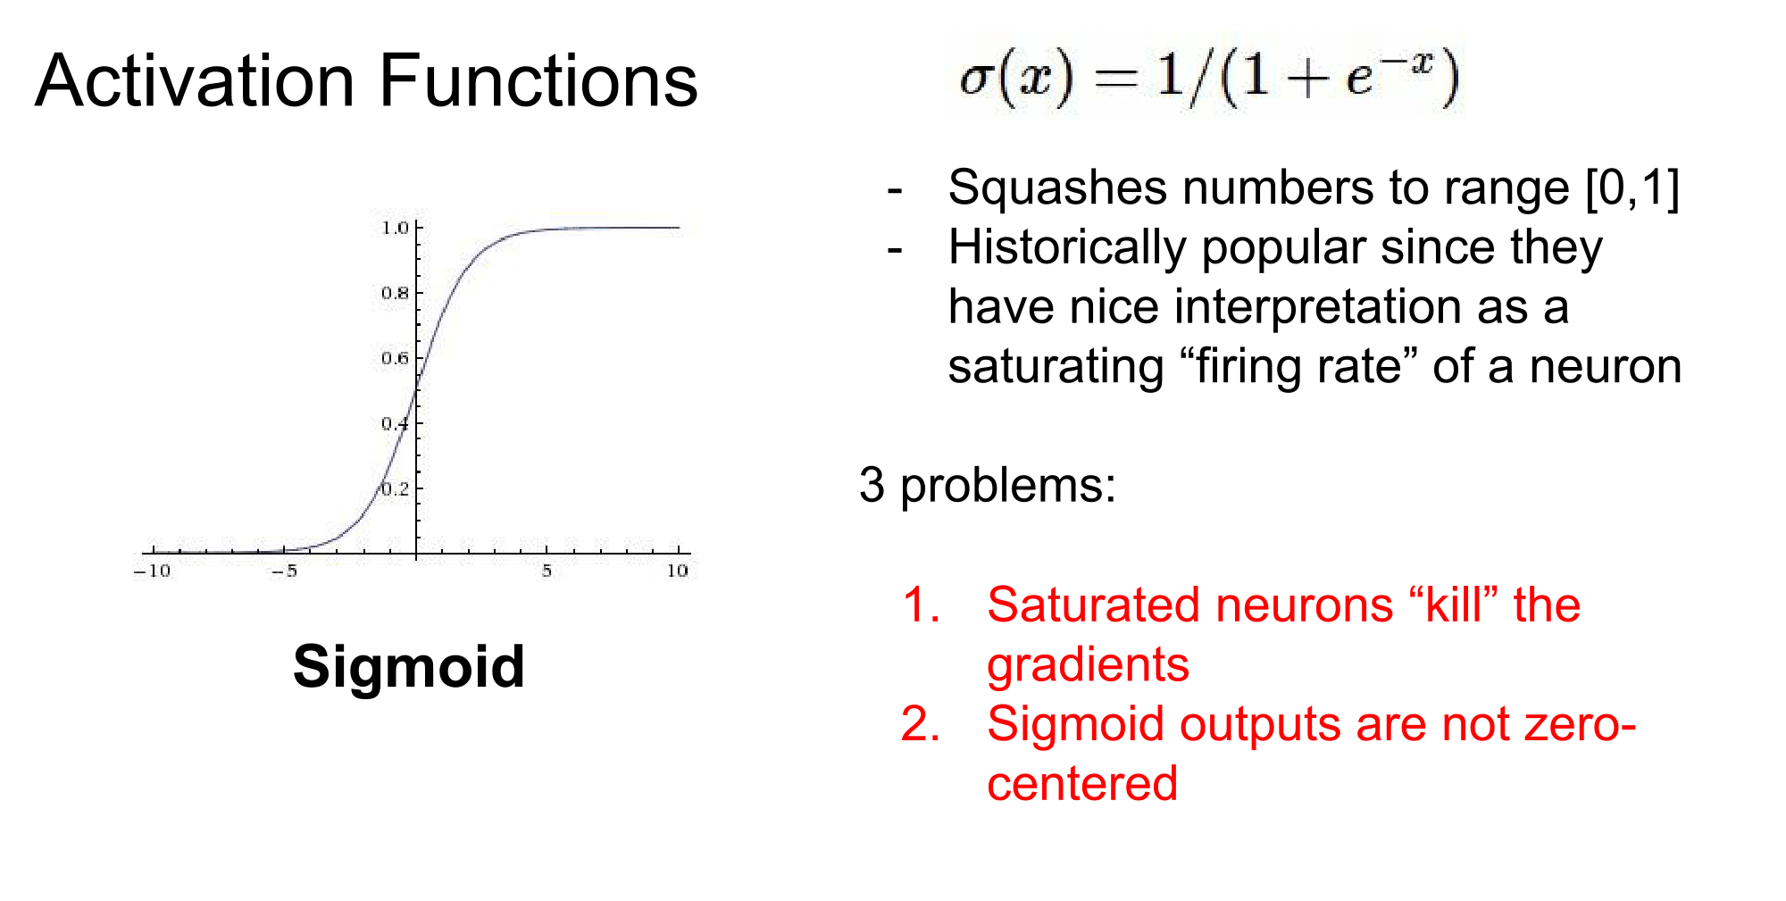

Slide 11
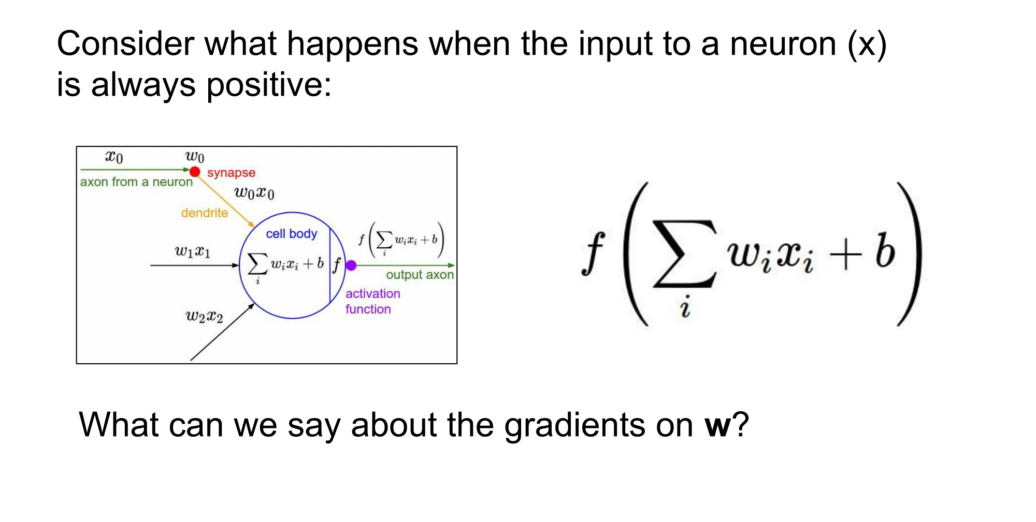

Slide 12
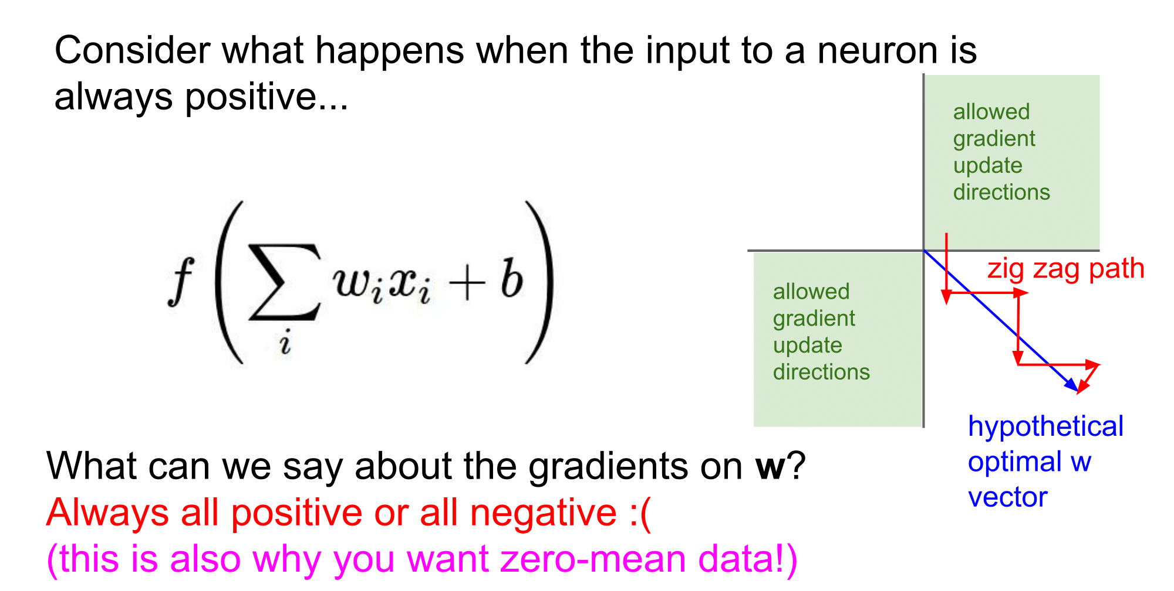
The sign of the gradient f Wi only depends on the sign of xi

Slide 13
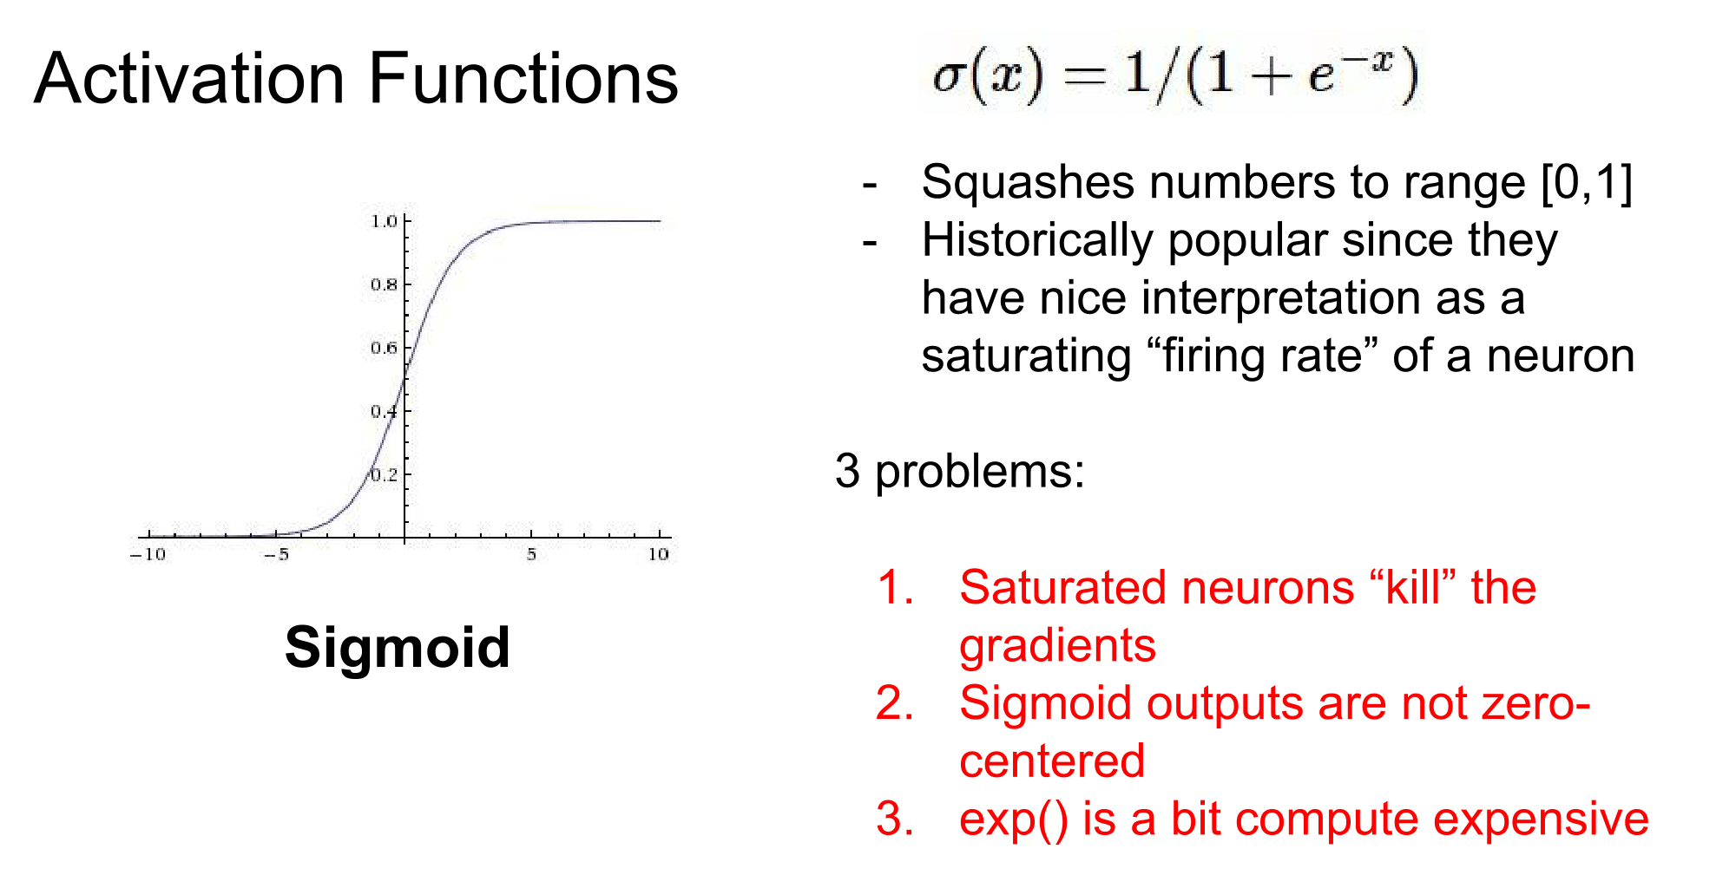

Slide 14
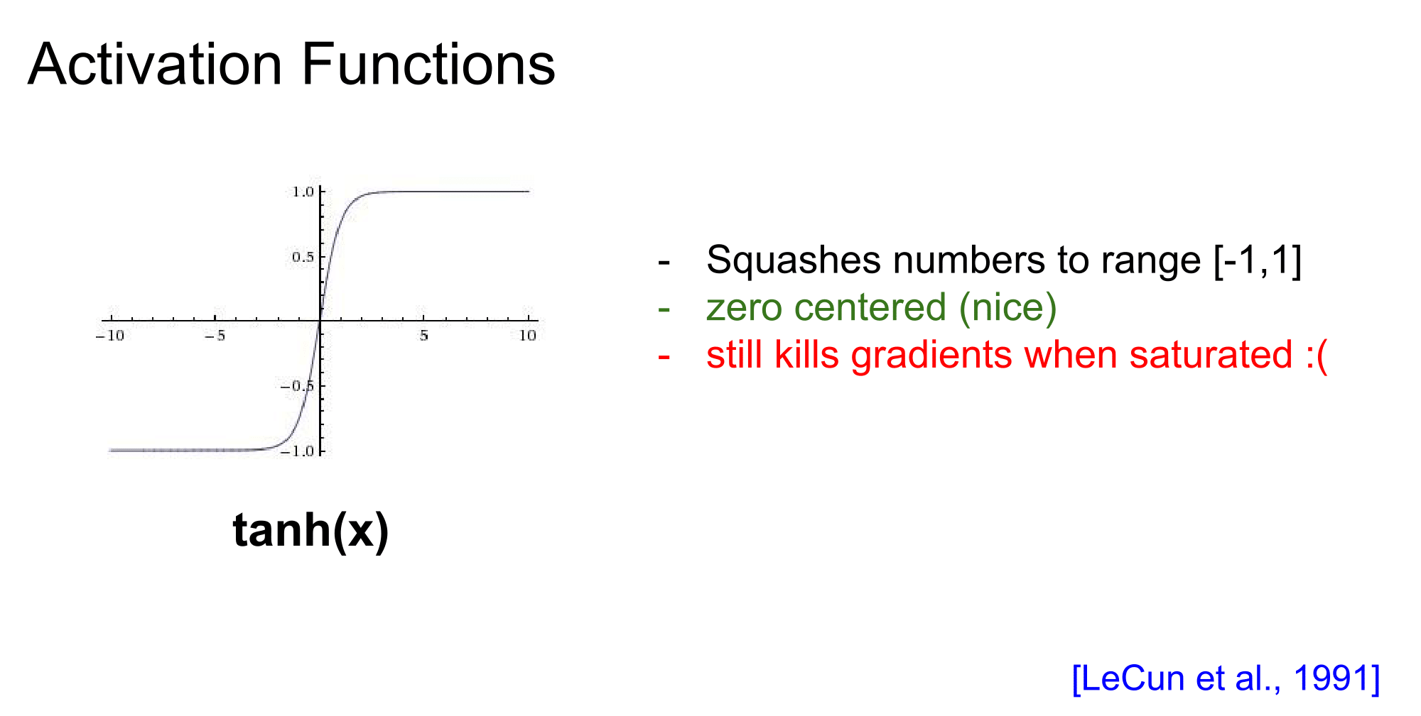

Slide 15
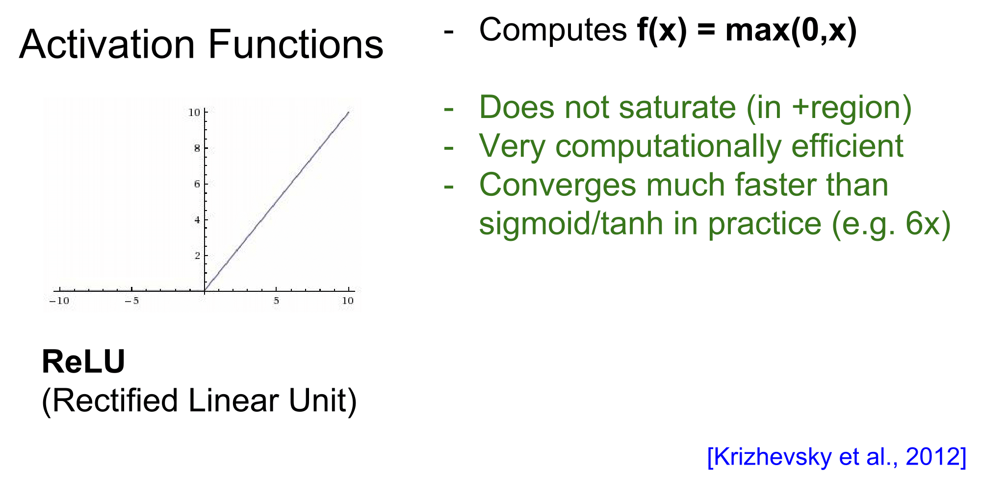

Slide 16
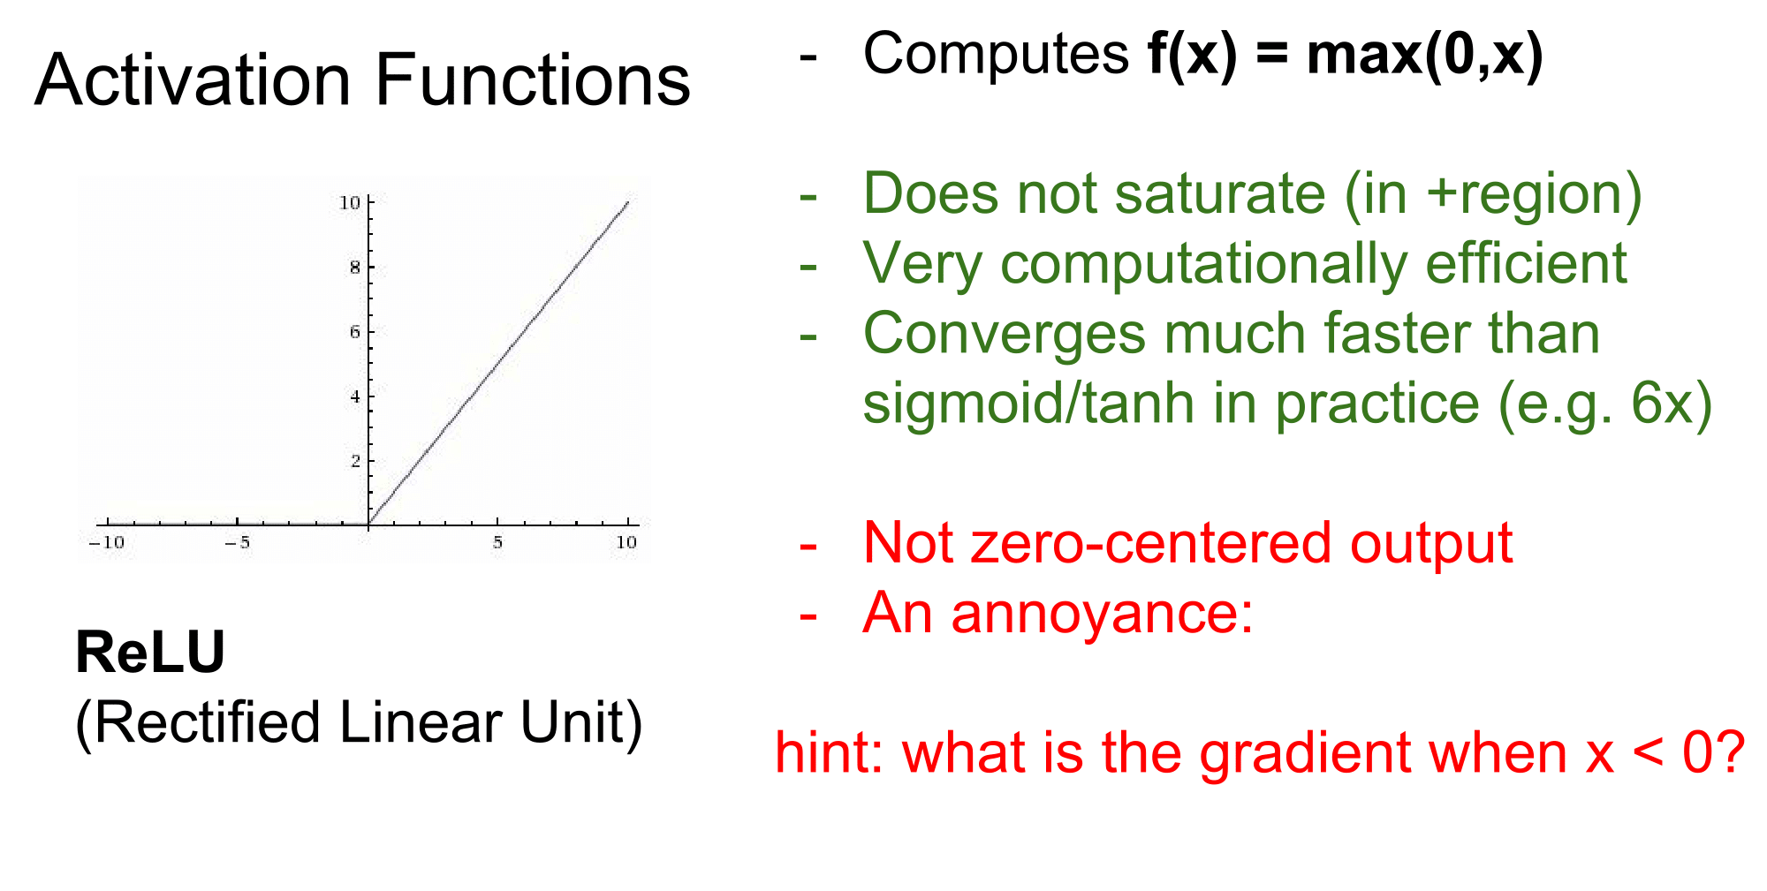

Slide 17
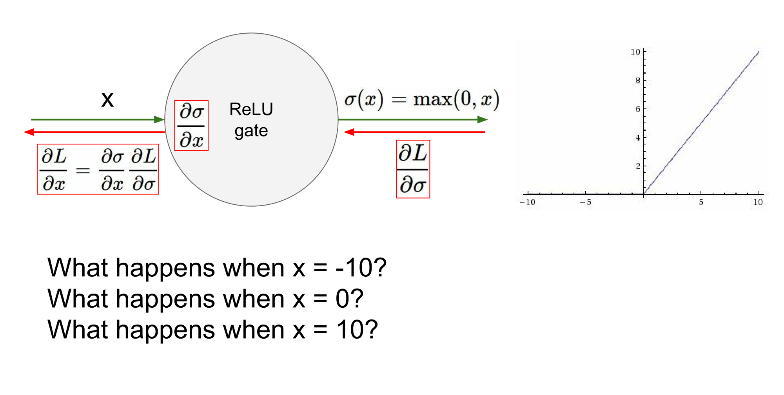

Slide 18
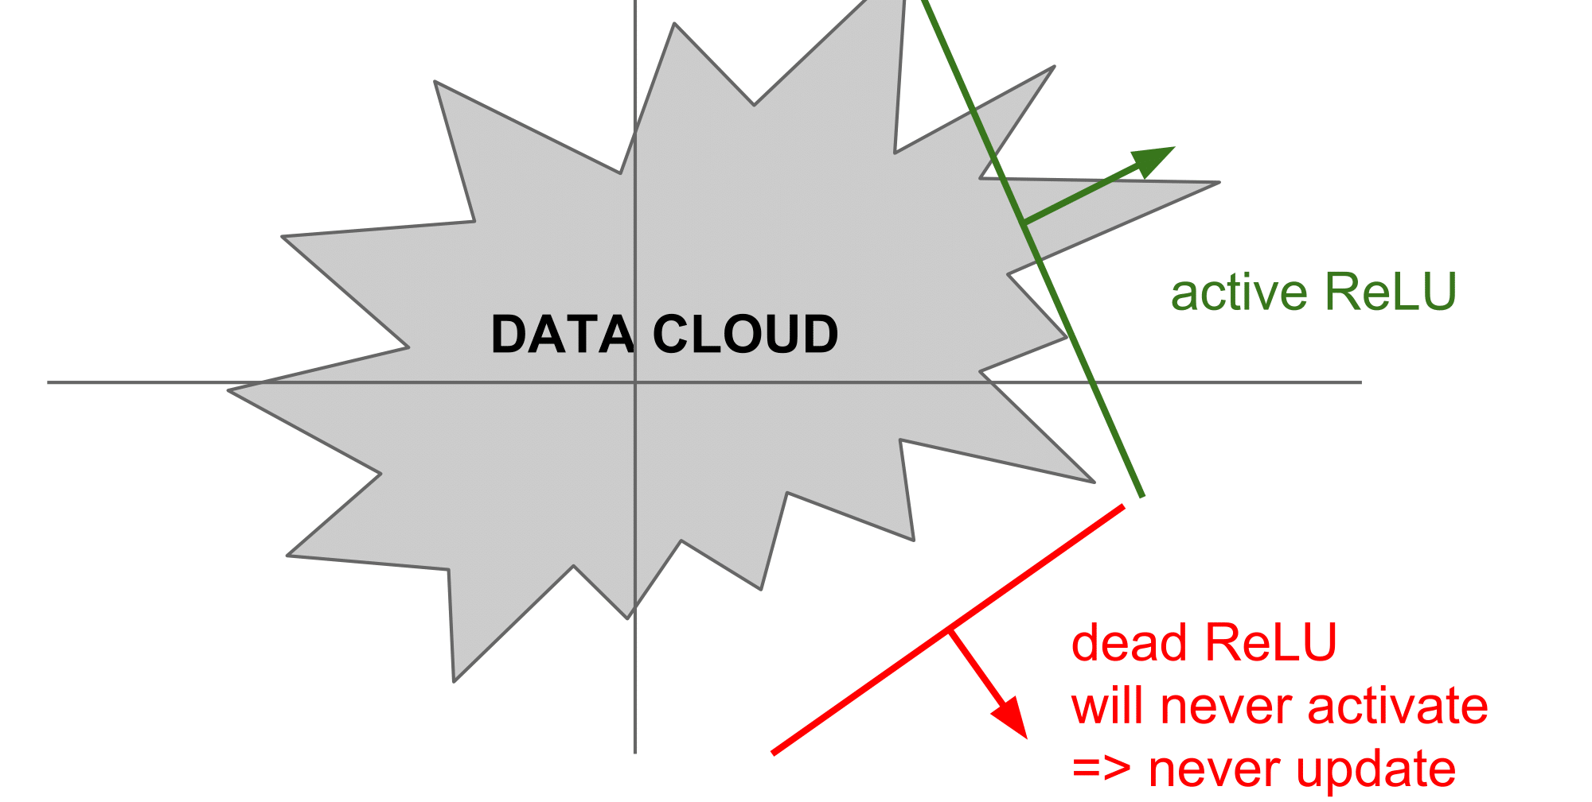

Slide 19
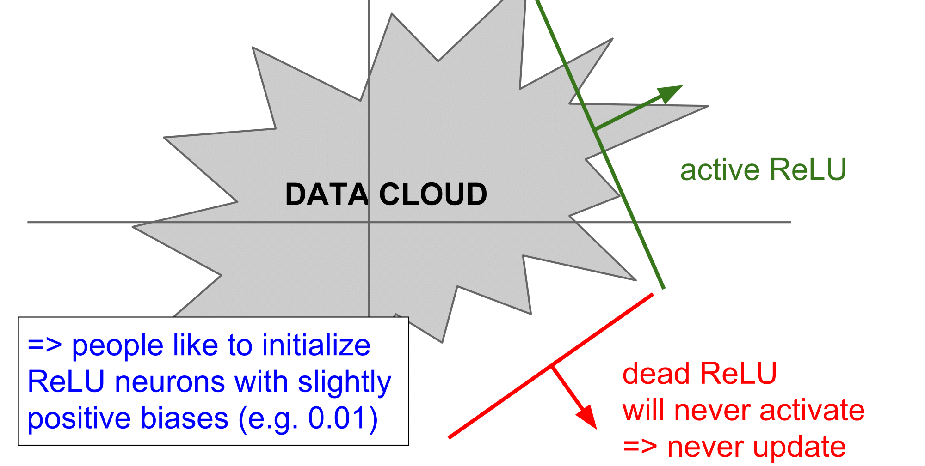

Slide 20
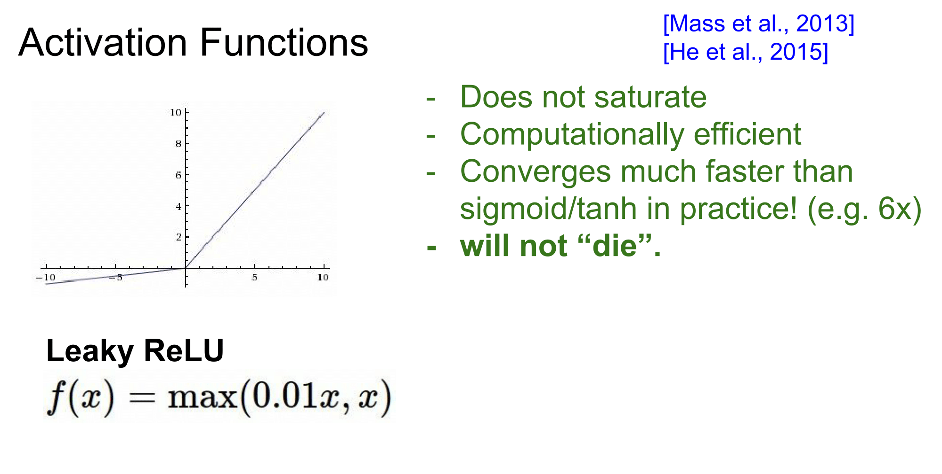

Slide 21
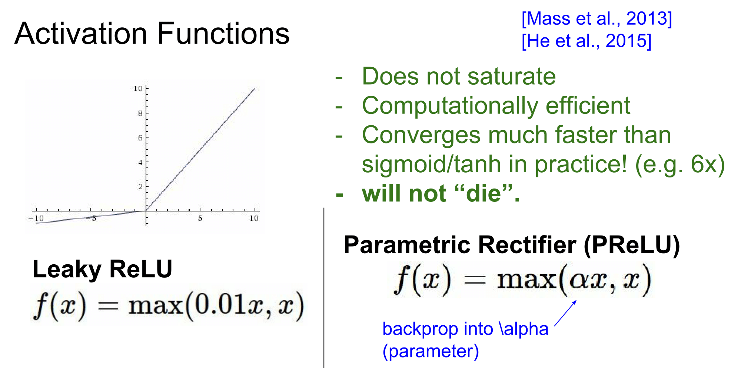

Slide 22
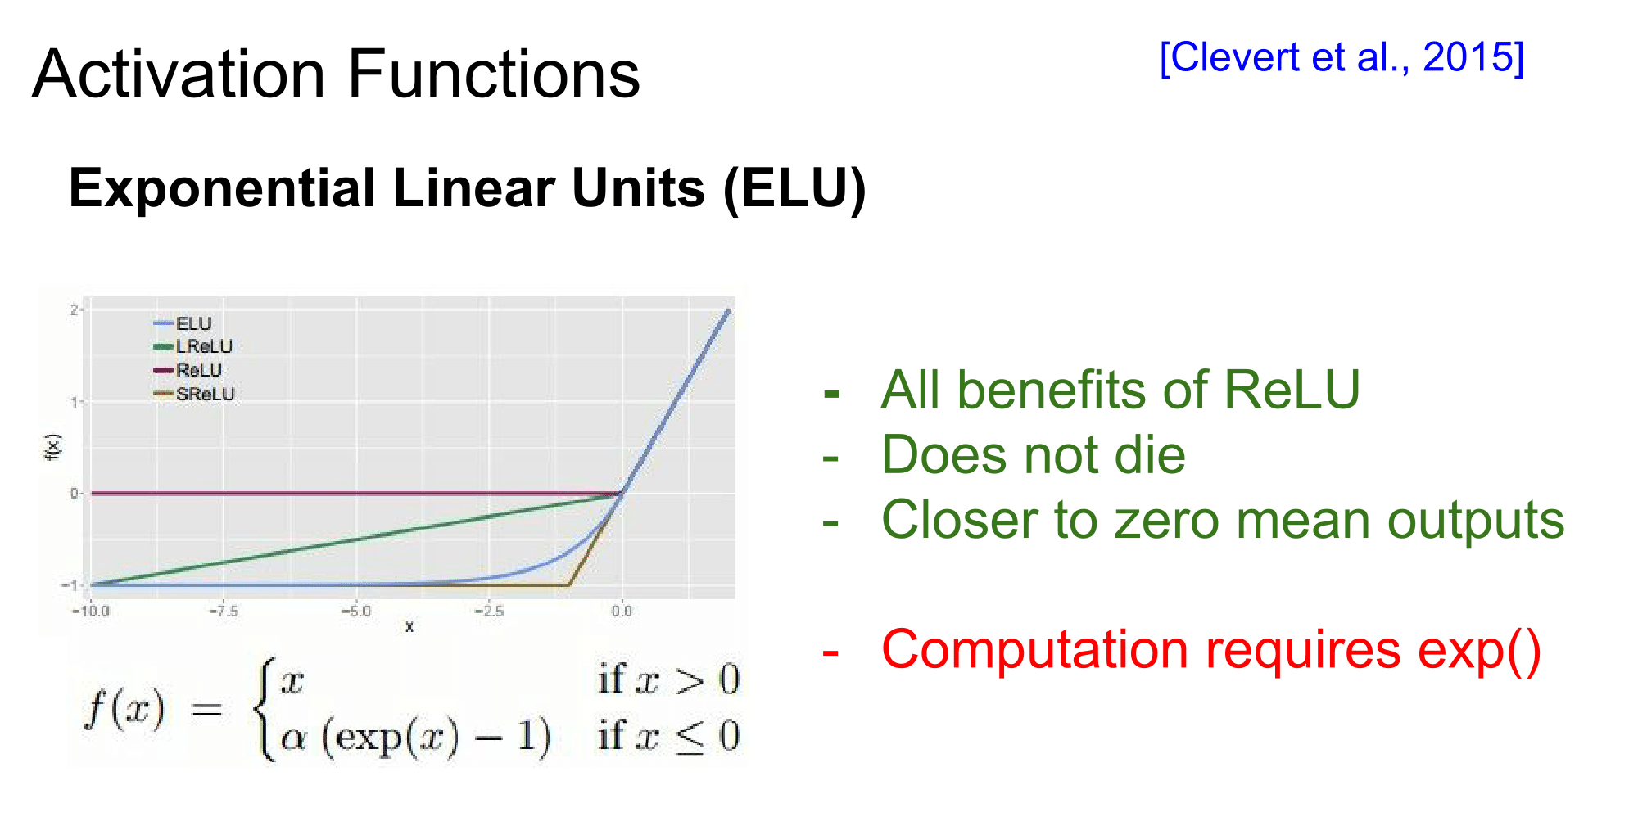

Slide 23
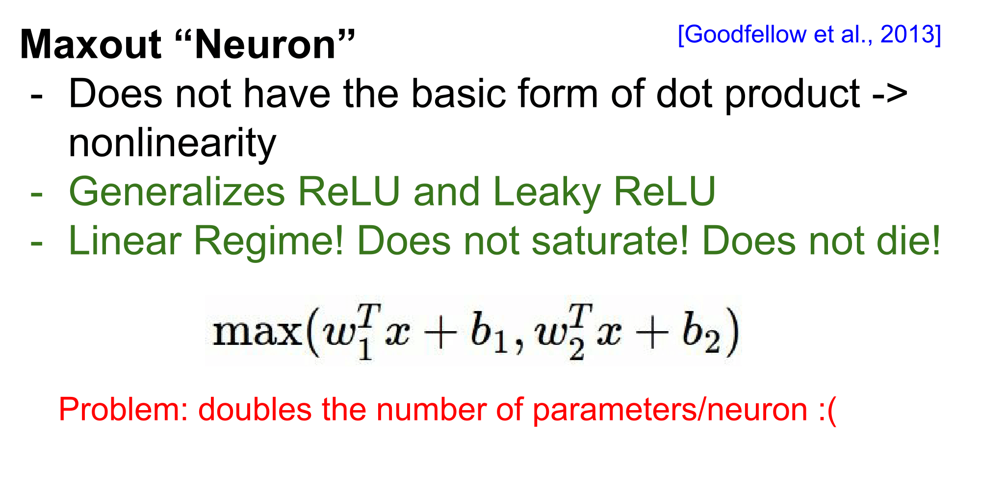

Slide 24
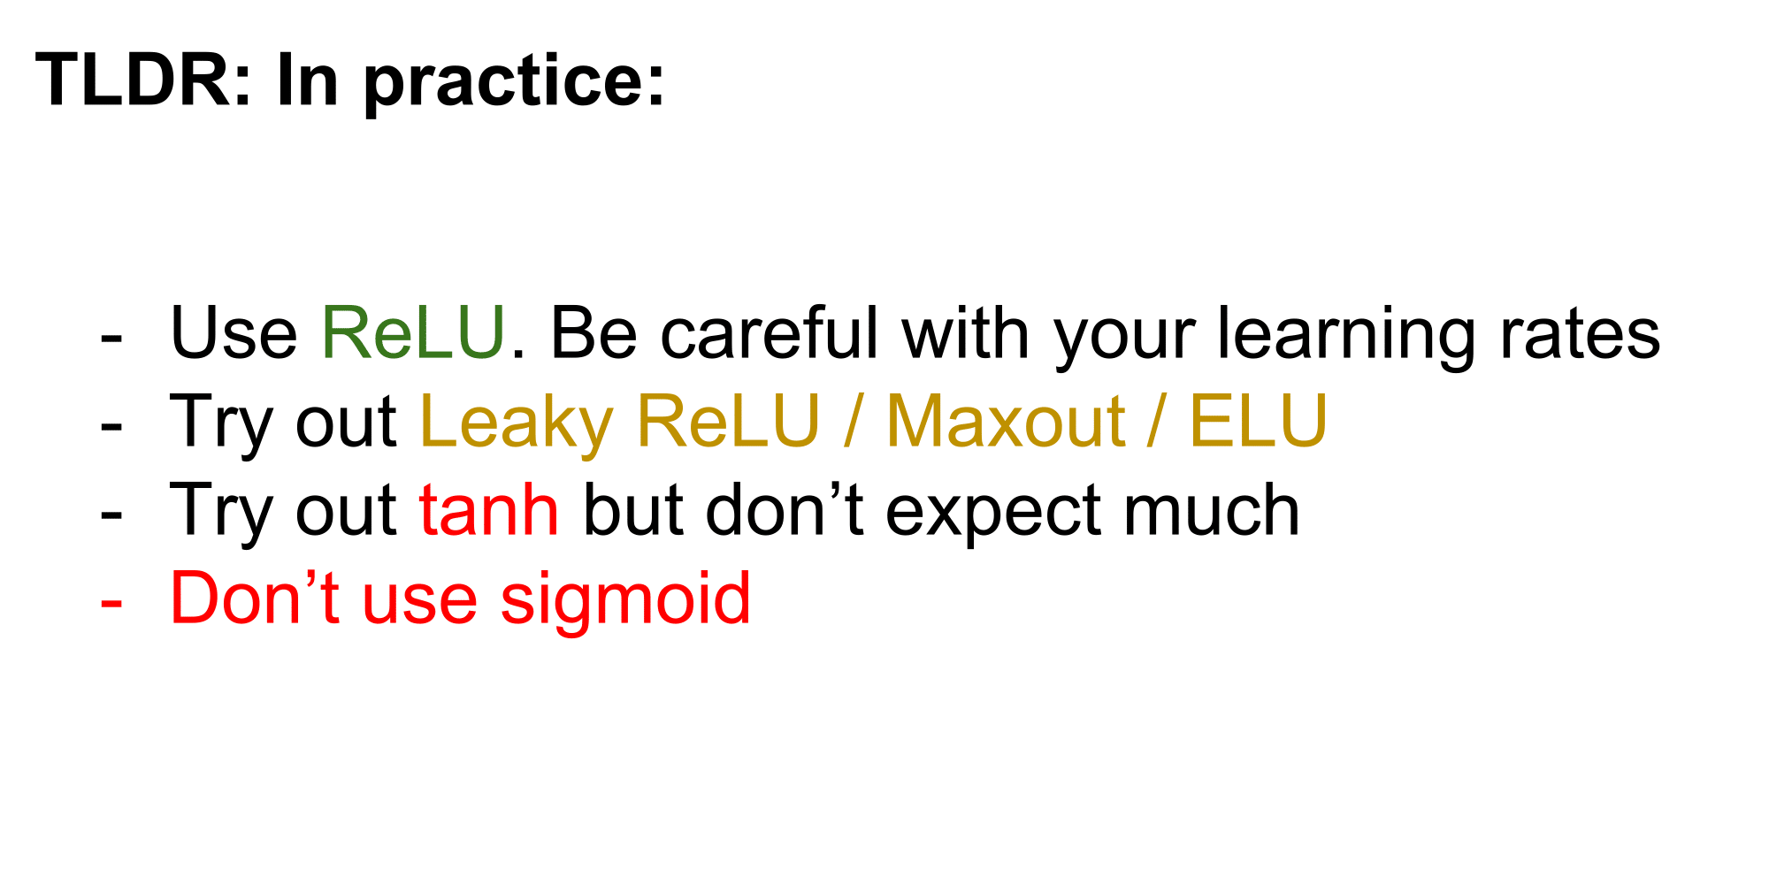

Slide 25
NN Architecture and Training

Slide 26
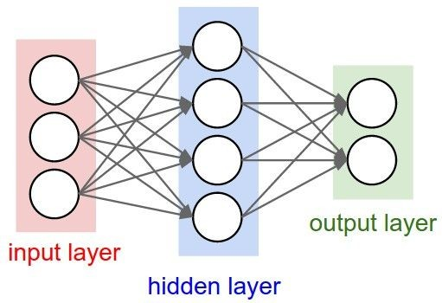
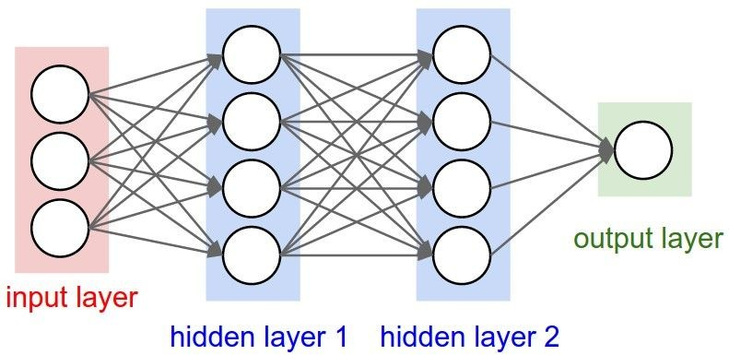
Neural networks: Architectures
“3-layer Neural Net”, or
“2-hidden-layer Neural Net”
“Fully-connected” layers
“2-layer Neural Net”, or
“1-hidden-layer Neural Net”

Slide 27
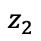
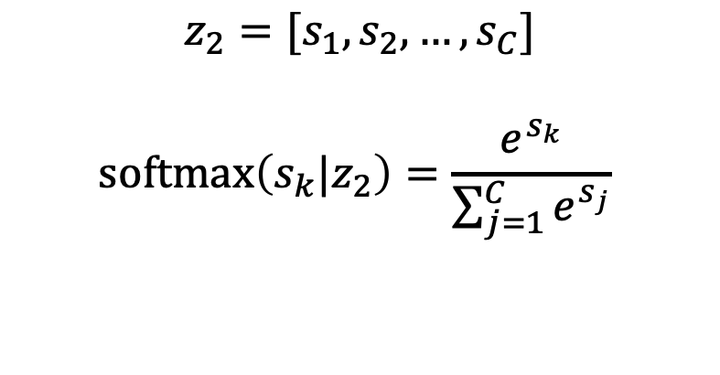
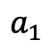
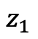
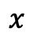
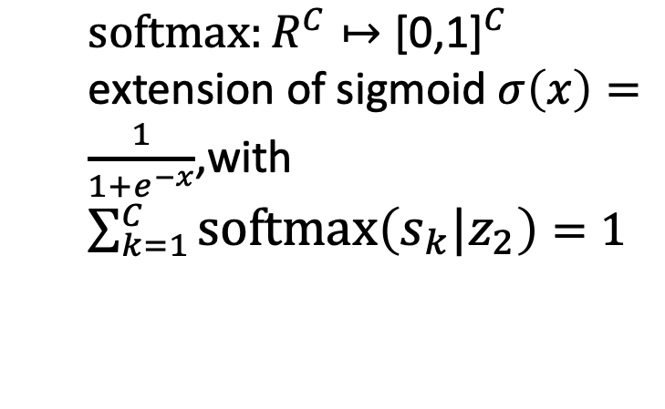
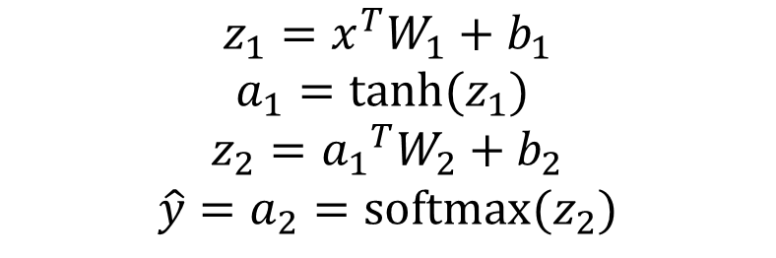
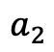
Forward
$$z_{1}$$
$$a_{1}$$
$$x$$
$$z_{2}$$
$$a_{2}$$
$$z_{1}=x^{T}W_{1}+b_{1}$$
$$a_{1}=tanh⁡(z_{1})$$
$$z_{2}={a_{1}}^{T}W_{2}+b_{2}$$
$${\hat{y}=a}_{2}=softmax(z_{2})$$
$$z_{2}=[s_{1},s_{2},…,s_{C}]$$
$$softmax\left(s_{k}|z_{2}\right)=\frac{e^{s_{k}}}{\sum_{j=1}^{C}{e^{s_{j}}}}$$
$softmax:R^{C}↦{\text{[0,1]}}^{C}$ extension of sigmoid $σ\left(x\right)=\frac{1}{1+e^{−x}}$,with$\sum_{k=1}^{C}{softmax\left(s_{k}|z_{2}\right)}=1$

Slide 28
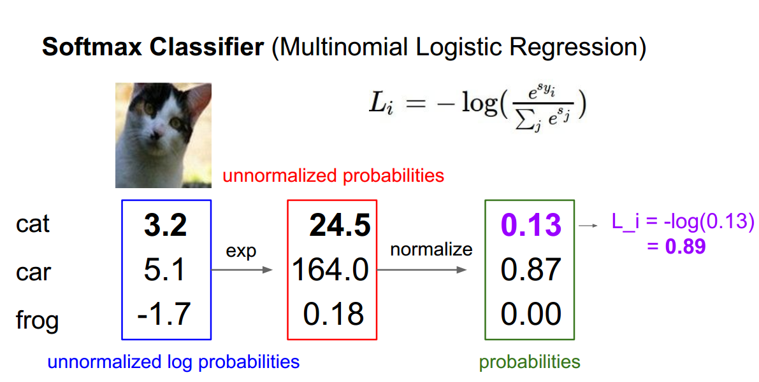
Loss function
Cross—entropy loss: two-class
One-hot label:
and

Slide 29
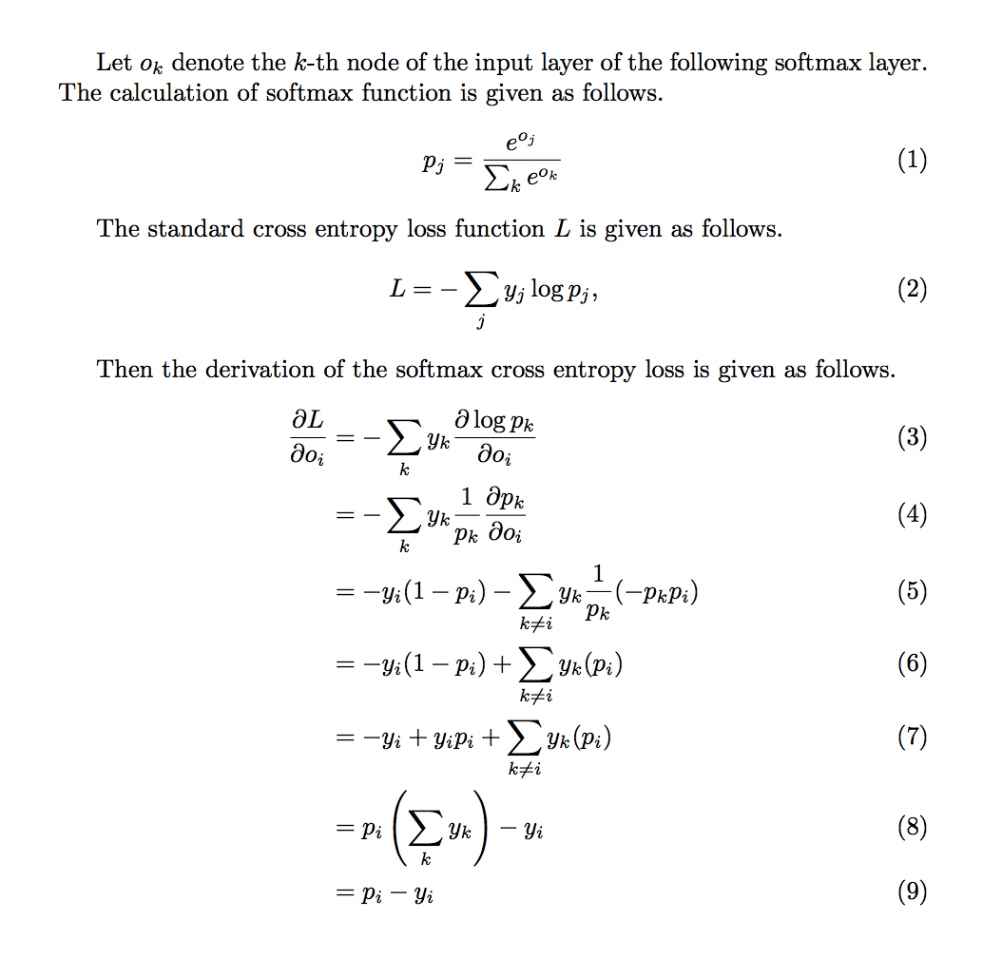
Back propagation

Slide 30
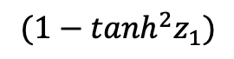
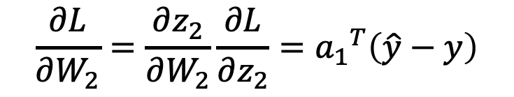
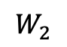
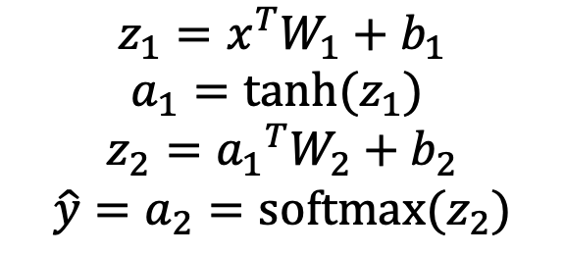
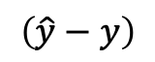
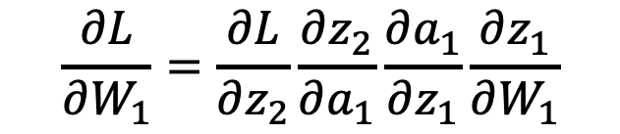



Back propagation
Backward:
$$\frac{∂L}{∂W_{2}}=\frac{∂z_{2}}{∂W_{2}}\frac{∂L}{∂z_{2}}={a_{1}}^{T}\left(\hat{y}−y\right)$$
Forward:
$$z_{1}=x^{T}W_{1}+b_{1}$$
$$a_{1}=tanh⁡(z_{1})$$
$$z_{2}={a_{1}}^{T}W_{2}+b_{2}$$
$${\hat{y}=a}_{2}=softmax(z_{2})$$
$$\frac{∂L}{∂b_{2}}=\frac{∂L}{∂z_{2}}\frac{∂z_{2}}{∂b_{2}}=\left(\hat{y}−y\right)$$
$$\frac{∂L}{∂W_{1}}=\frac{∂L}{∂z_{2}}\frac{∂z_{2}}{∂a_{1}}\frac{∂a_{1}}{∂z_{1}}\frac{∂z_{1}}{∂W_{1}}$$
$$\frac{∂ tanh⁡(x)}{∂x}=1−\tanh^{2}{(x)}$$
$$\left(\hat{y}−y\right)$$
$$W_{2}$$
$$(1−\tanh^{2}z_{1})$$
$$x^{T}$$

Slide 31


Back propagation
Backward:
$$δ_{3}=\hat{y}−y$$
$$δ_{2}=\left(1−\tanh^{2}\left(z_{1}\right)\right)∘δ_{3}W_{2}^{T}$$
$$\frac{∂L}{∂W_{2}}=a_{1}^{T}δ_{3}$$
$$\frac{∂L}{∂b_{2}}=δ_{3}$$
$$\frac{∂L}{∂W_{1}}=x^{T}δ_{2}$$
$$\frac{∂L}{∂b_{1}}=δ_{2}$$
Forward:
$$z_{1}=x^{T}W_{1}+b_{1}$$
$$a_{1}=tanh⁡(z_{1})$$
$$z_{2}={a_{1}}^{T}W_{2}+b_{2}$$
$${\hat{y}=a}_{2}=softmax(z_{2})$$

Slide 32

Summary
Ref: https://stanford.edu/~shervine/teaching/cs-230/cheatsheet-deep-learning-tips-and-tricks

Slide 33

Implementation
Forward:

Slide 34


Implementation
Backward:

Slide 35


Results

Slide 36


Slide 37


Slide 38
L0 regularization
Cost = $\sum_{i=0}^{N}{{(y_{i}−\sum_{j=0}^{M}{x_{ij}w_{j}})}^{2}}+λ{||w||}_{0}$
${||w||}_{0}$ means non-zero elements in $w$
${||w||}_{0}$ is non-convex and not differentiable.

Slide 39



L1 regularization
$L′\left(w\right)=\sum_{i=0}^{N}{{(y_{i}−\sum_{j=0}^{M}{x_{ij}w_{j}})}^{2}}+λ{|\left|w\right||}_{1}$
L1 regularization:
${|\left|w\right||}_{1}=\left|w_{1}\right|+\left|w_{2}\right|+…$
$L^{′}\left(w\right)=L\left(w\right)+λ$ ${|\left|w\right||}_{1}$
$\frac{∂L′}{∂w}=\frac{∂L}{∂w}+λ$ $sign(w)$
Parameter update:
$$w^{t+1}=w^{t}−η\frac{∂L^{′}}{∂w}=w^{t}−η\left(\frac{∂L}{∂w}+λ sign\left(w\right)\right)$$
= $w^{t}−η$ $\frac{∂L}{∂w}−ηλ$ $sign\left(w\right)$
$ηλ$ $sign\left(w\right) a$lways makes weight smaller (closing to zero)

Slide 40



L2 regularization
$L′\left(w\right)=\sum_{i=0}^{N}{{\left(y_{i}−\sum_{j=0}^{M}{x_{ij}w_{j}}\right)}^{2}}+λ\frac{1}{2}|{\left|w\right||}_{2}$
L1 regularization:
${|\left|w\right||}_{2}={\left|w_{1}\right|}^{2}+{\left|w_{2}\right|}^{2}+…$
$$\frac{∂L′}{∂w}=\frac{∂L}{∂w}+λw$$
$L^{′}\left(w\right)=L\left(w\right)+λ$ ${|\left|w\right||}_{2}$
Parameter update:
$$w^{t+1}=w^{t}−η\frac{∂L^{′}}{∂w}=w^{t}−η\left(\frac{∂L}{∂w}+λw^{t}\right)$$
= ${(1−ηλ)w}^{t}−η$ $\frac{∂L}{∂w}$
${(1−ηλ)w}^{t} a$lways makes weight smaller (closing to zero)

Slide 41

Regularization
Regularization就是向你的模型加入某些“规则”，加入先验，缩小解空间，减小求出错误解的可能性。
Ref: https://stanford.edu/~shervine/teaching/cs-230/cheatsheet-deep-learning-tips-and-tricks

Slide 42
More tricks for training deep networks
Optimizers: Adam, Momentum, AdaGrad, RMSProp, 2nd order, etc
Learning rates
Weight initialization
Regularization: dropout, early stopping, batch normalization, etc
…

Slide 43

Advanced optimization methods

Slide 44



Hessian and second-order methods
L(x)
Hessian in 1D
$$H\left(x\right)=\frac{∂^{2}L(x)}{∂x^{2}}=L′′(x)$$
$${\left[H\left(x\right)\right]}_{ij}=\frac{∂^{2}L(x)}{∂x_{i}∂x_{j}}$$
Hessian matrix when x is multi-dimensional:
Q: what is the dimension of Hessian matrix? Is it symmetric?
What does that mean in the sense of its eigenvalues?
TBD on blackboard: Taylor expansion of a 1D function,
geometric interpretation of eigenvalues of eigenvectors https://www.bilibili.com/video/BV1Ls411b7oL?spm_id_from=333.999.0.0

Slide 45


Hessian and second-order methods

Slide 46

Some interesting facts about gradient of NN
Consider a single-hidden-layer NN model: ${\hat{Y}=W}_{2}W_{2}X$ (note: a typical non-convex)
With training data $(X,Y)$ to minimize $|\left| \hat{Y}−Y\right|{\left.​\right|}_{F}^{2}$, under some technical condition,
can be shown $W_{2}^{T}W_{2}−W_{1}W_{1}^{T}=Cst$!!!
Details to be done on blackboard
Implicit regularization/bias in training NN with gradient descent!
Leads to a series of work in Deep Learning Theory
On the Optimization of Deep Networks: implicit Acceleration by Overparameterization, ICML 2018.
…

Slide 47


Slide 48


Slide 49


Slide 50


Slide 51

Data augmentation
Ref: https://stanford.edu/~shervine/teaching/cs-230/cheatsheet-deep-learning-tips-and-tricks

Slide 52


Slide 53


Slide 54
Back propagation
Backward:
$$δ_{3}=\hat{y}−y$$
$$δ_{2}=\left(1−\tanh^{2}\left(z_{1}\right)\right)∘δ_{3}W_{2}^{T}$$
$$\frac{∂L}{∂W_{2}}=a_{1}^{T}δ_{3}$$
$$\frac{∂L}{∂b_{2}}=δ_{3}$$
$$\frac{∂L}{∂W_{1}}=x^{T}δ_{2}$$
$$\frac{∂L}{∂b_{1}}=δ_{2}$$
Forward:
$$z_{1}=x^{T}W_{1}+b_{1}$$
$$a_{1}=tanh⁡(z_{1})$$
$$z_{2}={a_{1}}^{T}W_{2}+b_{2}$$
$${\hat{y}=a}_{2}=softmax(z_{2})$$

Slide 55


Slide 56


Slide 57


Slide 58


Slide 59


Slide 60

Recall the we use tanh activation function.

Slide 61


Slide 62


Slide 63


Slide 64




Slide 65


Slide 66
Batch Normalization

Slide 67


Slide 68


Slide 69


Slide 70

De-normalization:

Slide 71


Slide 72

Large batch size is required during training

Slide 73
Beyond Batch Normalization:
Weight normalization: Tim Salimans and Diederik P Kingma. Weight normalization: A simple reparameterization to accelerate training of deep neural networks. In Advances in Neural Information Processing Systems, pages 901–909, 2016.
Layer normalization: Jimmy Lei Ba, Jamie Ryan Kiros, and Geoffrey E Hinton. Layer normalization.
Instance normalization: D Ulyanov, A Vedaldi, and VS Lempitsky. Instance normalization: The missing ingredient for fast stylization.
Group normalization: Yuxin Wu and Kaiming He. Group normalization.
Batch renormalization: Sergey Ioffe. Batch renormalization: Towards reducing minibatch dependence in batch normalized models. In Advances in Neural Information Processing Systems, pages 1942–1950, 2017.

Slide 74
Dropout

Slide 75


Slide 76


Slide 77


Slide 78


Slide 79


Slide 80


Slide 81


Slide 82


Slide 83


Slide 84


Slide 85
Batch normalization and Dropout:
takes more time when doing training and inference/test
some researchers argue they CANNOT be used simultaneously in training DNNs, and with BN there is no need to do Dropout
Xiang Li, Shuo Chen, Xiaolin Hu and Jian Yang, Understanding the Disharmony between Dropout and Batch Normalization by Variance Shift, CVPR 2019.

Slide 86


Slide 87


Slide 88


Slide 89


Slide 90


Slide 91


Slide 92


Slide 93


Slide 94


Slide 95


Slide 96


Slide 97


Slide 98


Slide 99


Slide 100


Slide 101


Slide 102
实践内容
BP神经网络的numpy实现
依照课件上的内容，采用numpy实现BP神经网络，在half moon上可视化非线性分类。
无需提交报告，完成之后下周待续。。。

